Slide 1
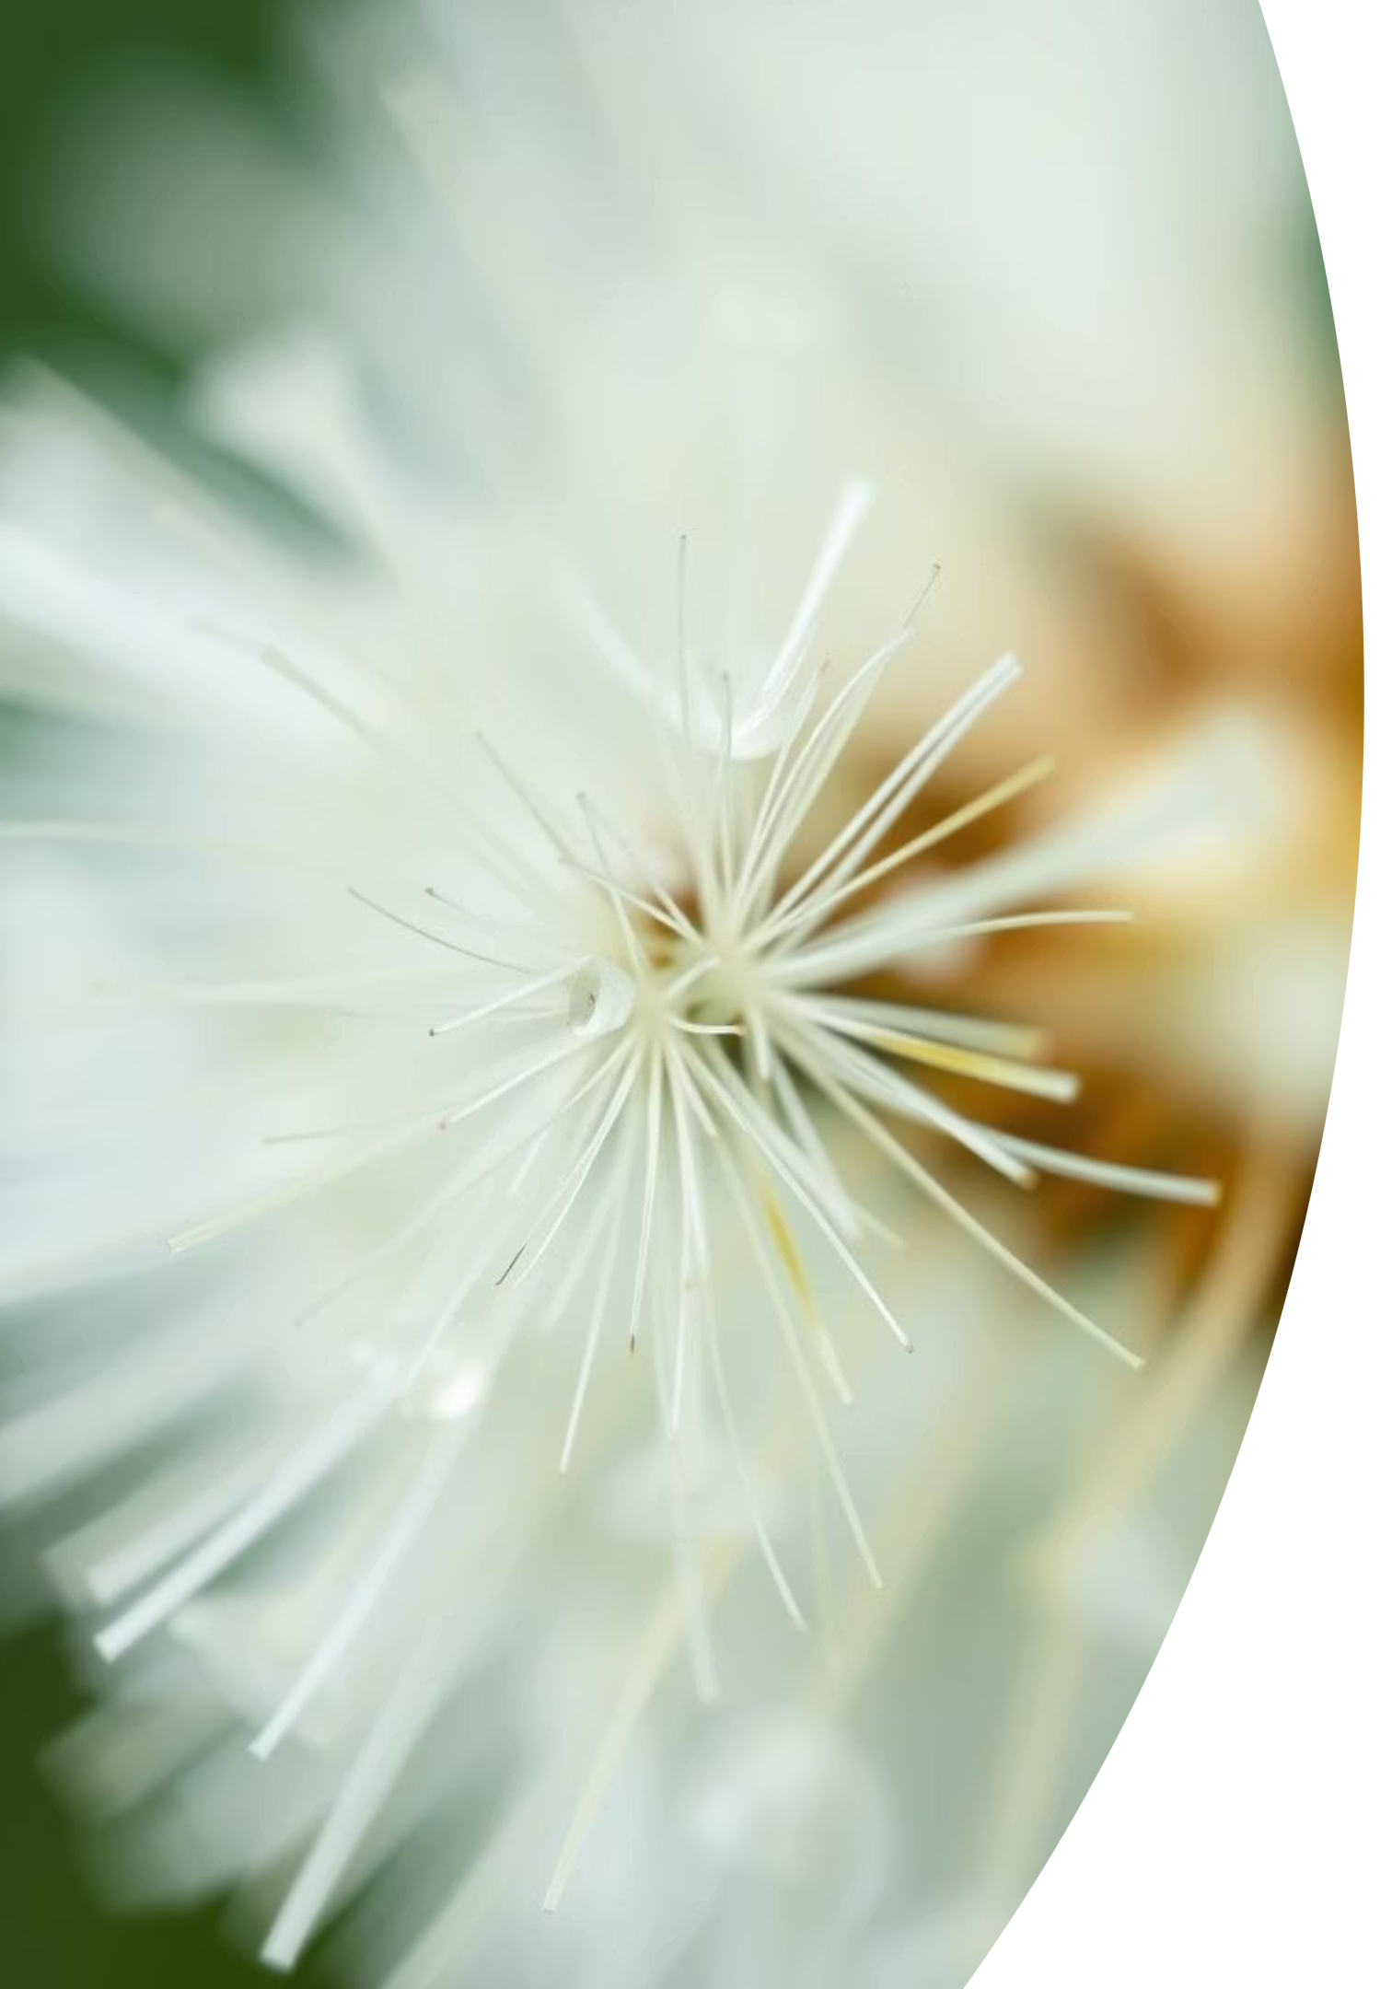
Pollen’s Profiling: Automated Classification of Pollen Grains
Welcome to Pollen's Profiling! Our project focuses on revolutionizing pollen analysis through automated classification using deep learning. This presentation outlines our methodology, findings, and the exciting future of this technology.

Slide 2
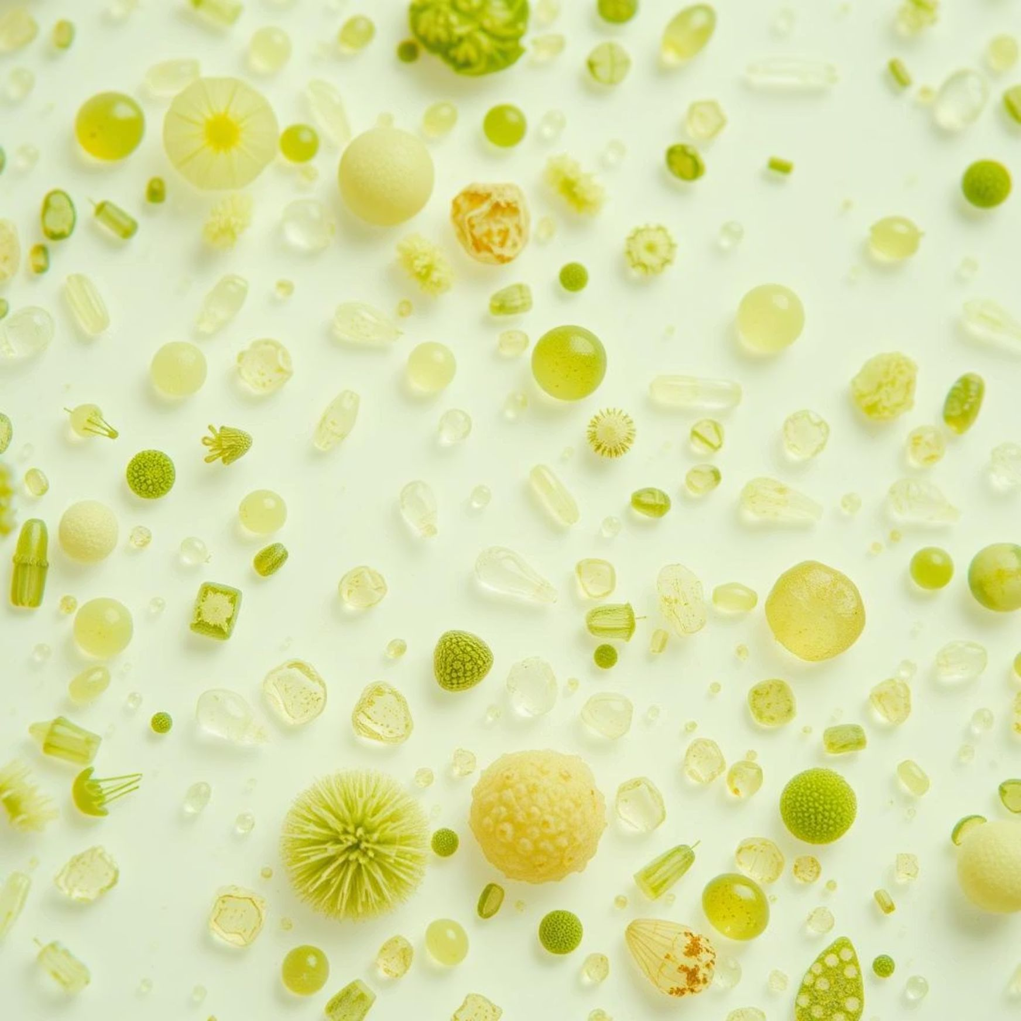
Introduction to Automated Pollen Classification
Addressing Manual Limitations
Diverse Applications
Manual pollen classification is time-consuming and prone to human error. Our project automates this critical process using advanced deep learning techniques.
Automated pollen classification has wide-ranging applications, from allergy research and agricultural studies to forensic analysis and honey purity testing.
Dataset Overview
Total Images: 790 high-resolution images.
Classes derived directly from folder names, ensuring clear categorization.
Visual class distribution analyzed via bar plots for insight.
Sample images from each class showcased for diverse representation.

Slide 3
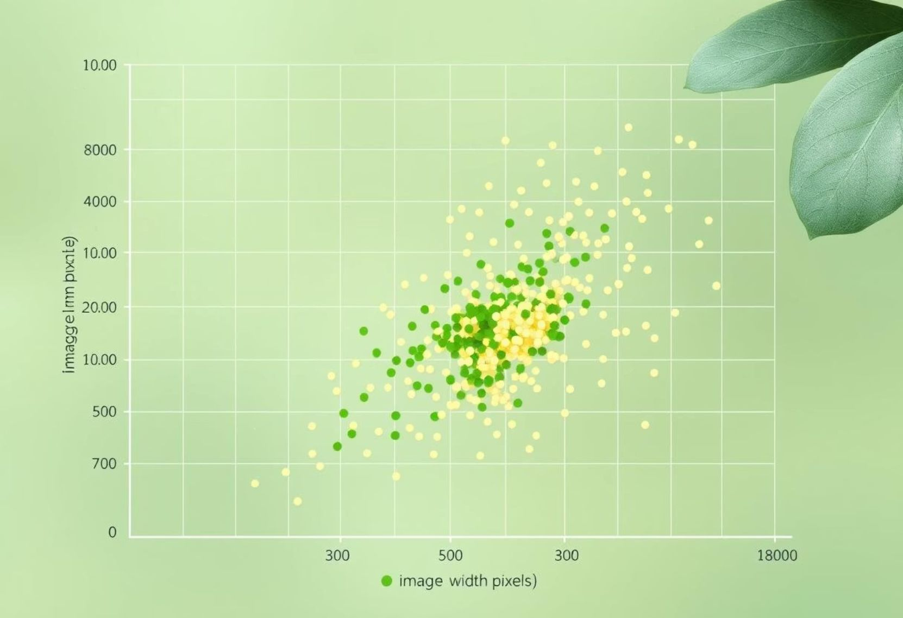
Image Analysis and Preprocessing
Image Size Distribution
Data Preprocessing Steps
We analyzed image dimensions using OpenCV. A scatterplot revealed that the majority of images comfortably fit within an 800x800 pixel window, optimizing processing efficiency.
Images were normalized using OpenCV to standardize pixel values across the dataset.
All images were consistently resized to 128x128 pixels, preparing them for model input.
Labels were efficiently encoded using LabelEncoder.
One-hot encoding was applied to the labels for robust multi-classification.

Slide 4

Model Architecture and Data Splitting
Data Splitting Strategy
Data was split into training and testing sets with approximately 71.5% for training and 28.5% for testing.
Stratified sampling was employed to ensure proportional representation of all pollen classes in both sets.
Class weights were utilized to balance the dataset, addressing any potential class imbalances.
CNN Model Architecture
3 Convolutional Layers
Normalization & Pooling
Featuring increasing filter sizes (32, 64, 128) to extract hierarchical features.
Batch Normalization for stable training and MaxPooling for dimensionality reduction.
Dense & Output Layers
Regularization
A 256-unit dense layer feeds into a 23-neuron softmax output layer for classification.
Dropout layers are strategically placed to prevent overfitting.

Slide 5
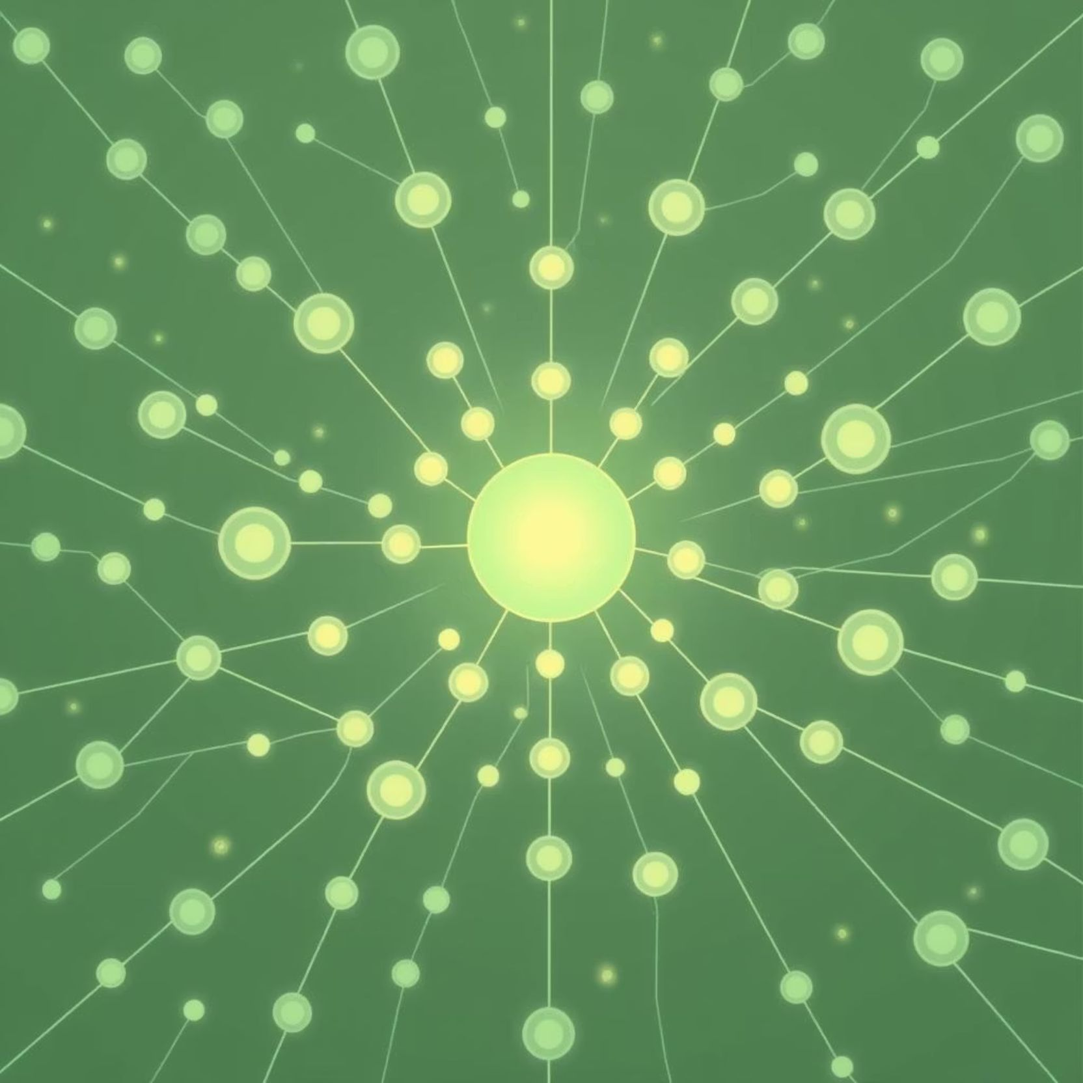
Model Summary and Optimization
Key Model Statistics
The model boasts a substantial 8.48 Million total parameters, all trainable.
A minimal 448 non-trainable parameters, indicating an efficient architecture.
Optimization Details
We utilized the Adam Optimizer for its adaptive learning rate capabilities.
The Categorical Crossentropy loss function was chosen, perfectly suited for multi-class classification tasks.

Slide 6
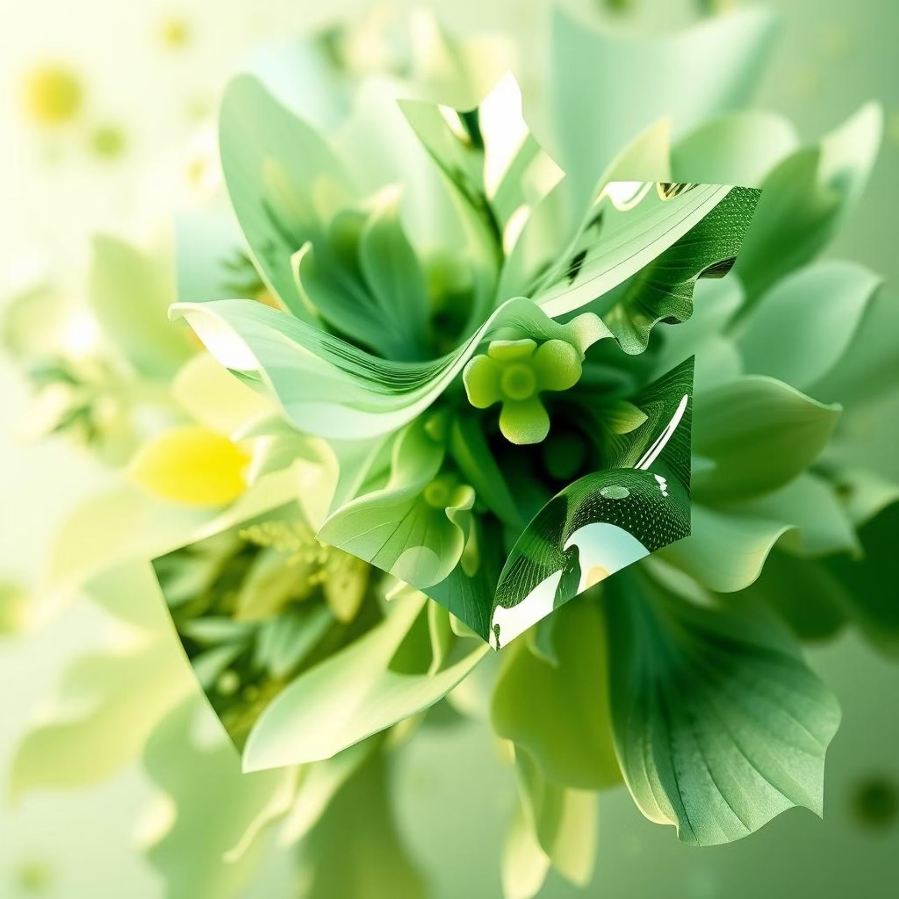
Training Setup and Results
Training Configuration
ImageDataGenerator was instrumental for real-time data augmentation.
The model was trained over 500 epochs with a batch size of 32.
Augmentation included rotation, zoom, shifts, and horizontal/vertical flips for enhanced generalization.
Training Results Overview
200+
85-90%
Epochs Trained
Final Accuracy
The model was rigorously trained for over 200 epochs.
Achieved a high final accuracy of approximately 85-90%.
100
89.82%
Loss Stabilization
Peak Validation Accuracy
Loss functions stabilized consistently after 100 epochs.
Validation accuracy reached an impressive peak of 89.82%.

Slide 7
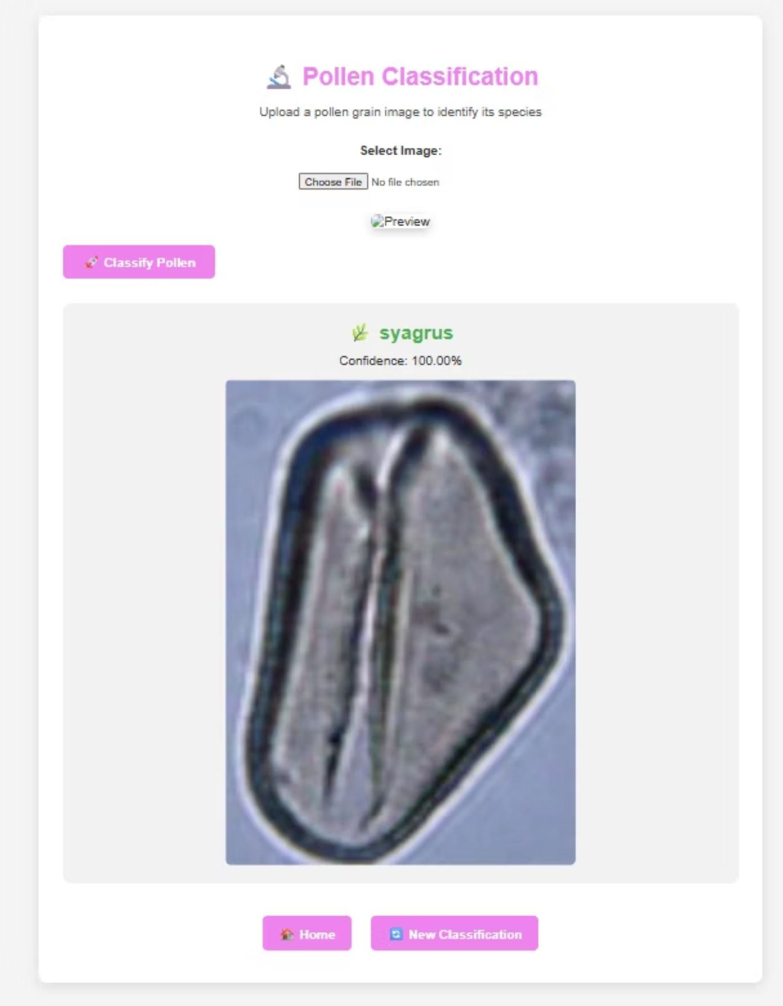
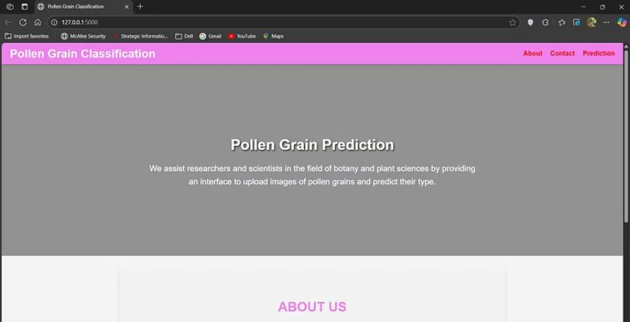
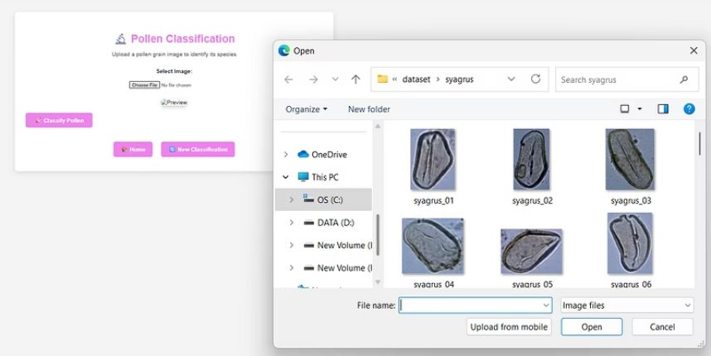
sample outputs
← classified output
home page prediction page
↓ ↓

Slide 8

Key Observations and Conclusion
Key Observations
Balanced Training: Implementing balanced training techniques significantly improved model stability and performance.
Overfitting Mitigation: Data augmentation and dropout layers were highly effective in preventing overfitting, ensuring robust generalization.
Class Imbalance Handling: The use of class weights successfully addressed and mitigated challenges posed by class imbalance in the dataset.
Project Conclusion
Automated Pollen Classifier
High Accuracy with CNN
Real-time Application Potential
We successfully developed and implemented an automated system for pollen grain classification.
Our Convolutional Neural Network (CNN) demonstrated exceptional accuracy on the unseen test set.
The model's performance suggests strong potential for extension into real-time applications using TFLite.

Slide 9

Future Work and Deployment
Our successful classification model lays the groundwork for exciting future developments, focusing on deployment and enhanced functionality.
Model Quantization for Edge Devices
Flask Web App Deployment
We plan to quantize the model for efficient deployment on edge devices, enabling real-time, on-site pollen analysis.
Our immediate next step is to deploy the model as a user-friendly web application using Flask, enabling easy access and interaction.
Microscopy Preprocessing Filters
Dataset Expansion
Incorporating advanced microscopy preprocessing filters will improve image quality and, consequently, classification accuracy.
Expanding the dataset to include more pollen types will further enhance the model's robustness and applicability across diverse flora.

